Slide 1
Hiring Process Analytics
By Gayatri Palkar

Slide 2
Contents
Data Preprocessing
Data Analytics Tasks
Project Report

Slide 3
Data Preprocessing

Slide 4
Handling Missing Data: Decide on the best strategy to handle them.
Missing values in this data exists in forms of blank data cells or hyphens ‘-’ in place of data
I found a blank cell in Offered Salary column, when i checked the minimum and maximum value of column, the difference was too big, so I decided to omit complete row of data, instead of taking the mean, median or mode of data, as there is too much variety and range
The other columns where I found missing data were categorical data points, hence even there i decided to drop the complete record.

Slide 5
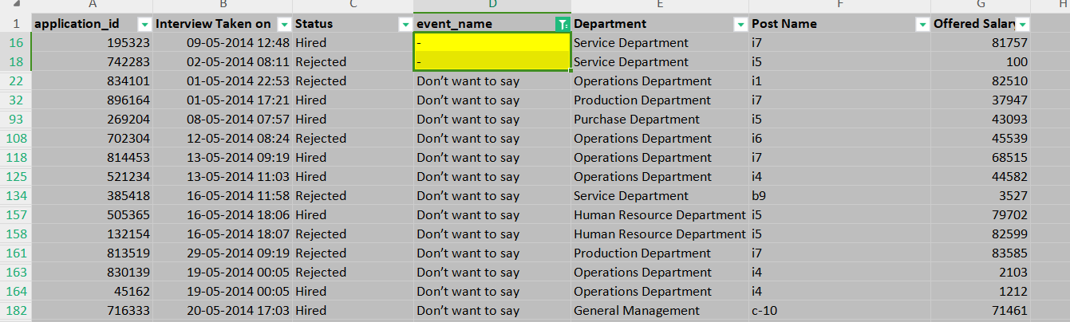
I found another column with missing values, event_name column, there should have been two options here: Male and Female, but due to user confidentiality, few applicants had selected “Don’t want to say” in in Gender and there were also few hyphenated cells, so I decided to convert the hyphen data cells to “Don’t want to say”, as it will reduce the number of variables at least by 1. As number of “Don’t want to say” is very high, I decided to not drop all the cells ( there were 408 entries with this)

Slide 6
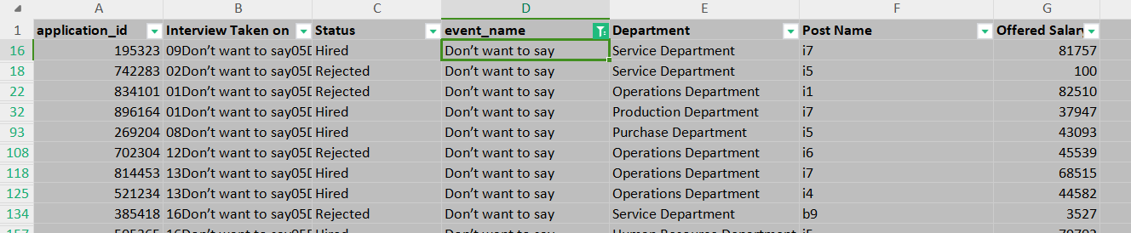
Steps
In both the cases: I selected the blanks and deleted the rows manually using::
Select data using Ctrl+A
F5
Select ->Blanks
Delete rows
Same with Hyphenated Data rows

Slide 7
II. Clubbing Columns: Do so to simplify your analysis.
I took a careful look at the data and decided that the Department and Post Name as both of them provide similar information, I’ll explain how.
One Department will have many applicants applying for different posts for the overall development of the project as a whole end to end.
And further on combining these two will help us understand how many people applied for a specific post in a specific department. And will make our analysis easier.

Slide 8
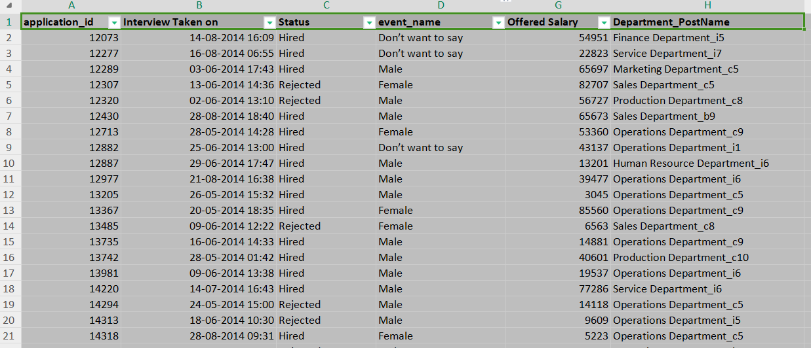
Steps
For creating a new column by concatenating 2 columns I used the formula:
=CONCATENATE(E1,"_",F1)
This joined the 2 columns, then I dragged down the cursor to apply it to the complete column
Hid the other 2 columns from view

Slide 9
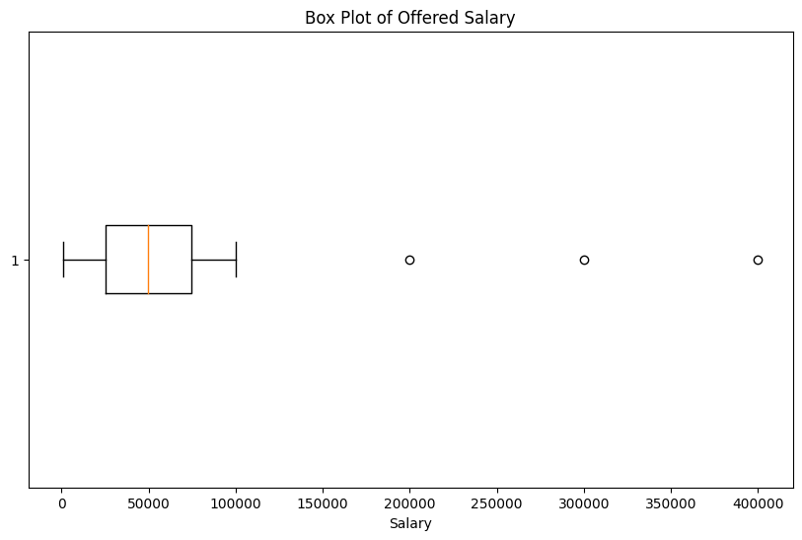
III. Outlier Detection: Check for outliers in the dataset that may skew your analysis.
To detect outliers, we will have to plot a box plot.
Since I don't have “Boxes and Whiskers” feature in my Excel, I decided to plot a boxplot using python
We can see in the image that there are 3 outliers, so now to detect them using Excel I will use Quartile function

Slide 10
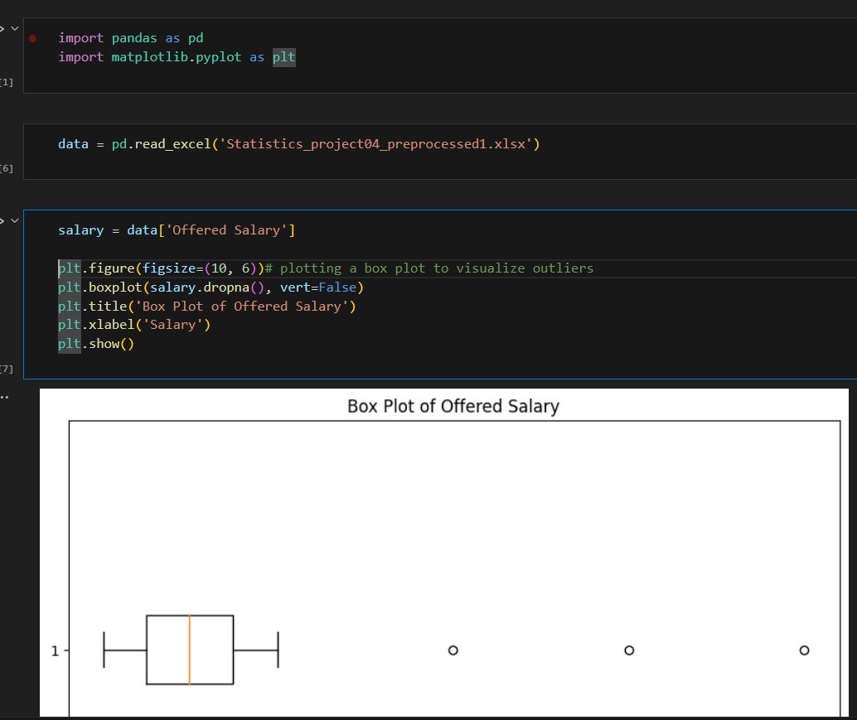
Python code for box plot

Slide 11
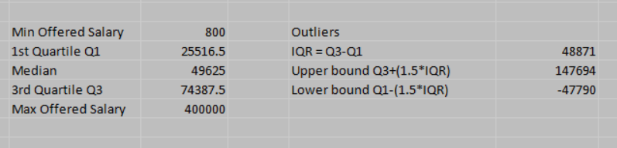
Outliers using Excel
To detect the outliers, I will start by finding the Min and Max values from OfferedSalary column
Then I will find the Median, Q1 and Q3 using QUARTILE function:
=QUARTILE(G:G,1) and =QUARTILE(G:G,3) and =MEDIAN(G2:G7152)
Then find the Interquartile range(IQR) using formula: =M22-M20 i.e Q3 - Q1

Slide 12
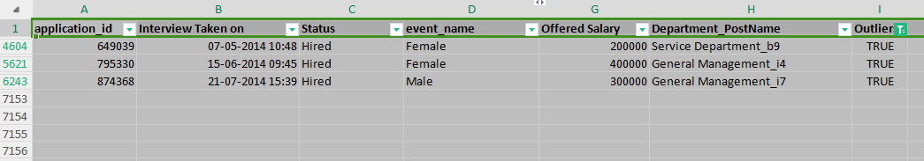
Outliers using Excel
Then I calculated the Upper bound and Lower bound : =M22+(1.5*P20) and =M20-(1.5*P20)
using formula: Upper bound = Q3+(1.5*IQR) and Lower bound = Q1-(1.5*IQR)
Then I used a OR function and created a new column called Outliers and compare the data value with upper and lower bound as : =OR(G2>$P$21,G2<$P$22)
This gave me a new column with True and False values for outliers
I filtered data on True values and got below output

Slide 13
IV. Removing Outliers/Anomalies: Decide on the best strategy to handle outliers.
The outliers are very far away from out data and hence will not provide a meaningful insight, so I will remove the outliers completely from the data
Delete outliers and clean up data
The Outliers are now deleted, I will also delete or hide the new column Outliers as our job for cleaning the data is done.
I will now start with further analysis

Slide 14
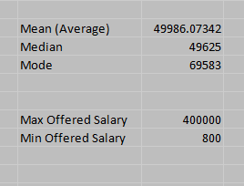
V. Data Summary: Summarize the findings.
I found the Statistical measures like Mean, Media, Mode from the OfferedSalary column, the only numerical column in data
Also found the maximum and minimum salary offered
Have also checked the data and removed any Outliers, as it might change further analysis.
We can see that the mean and median of salaries is similar approx. but salary of 69K is appearing most in the data. But this information is not very valuable. We can further divide these values for department and post-wise Salary
Let us get into few visualizations using Excel

Slide 15
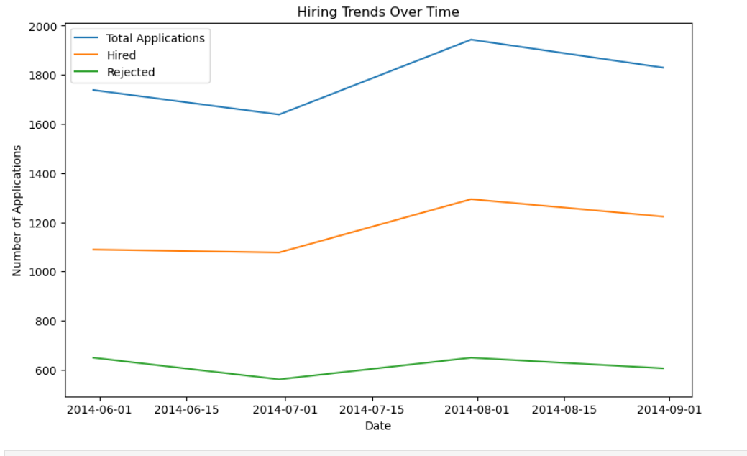
Creating visualizations to better understand the data.
We can look at Hiring trends over time:
Filter Status column to keep only the Hired values (plotted using matplotlib)
Plot time series plot on Status column
Interview Taken on is the time column
We can see that the number of applications increased during August month, that is after the appraisal period of most companies, so applicants usually apply after graduation or appraisal.

Slide 16
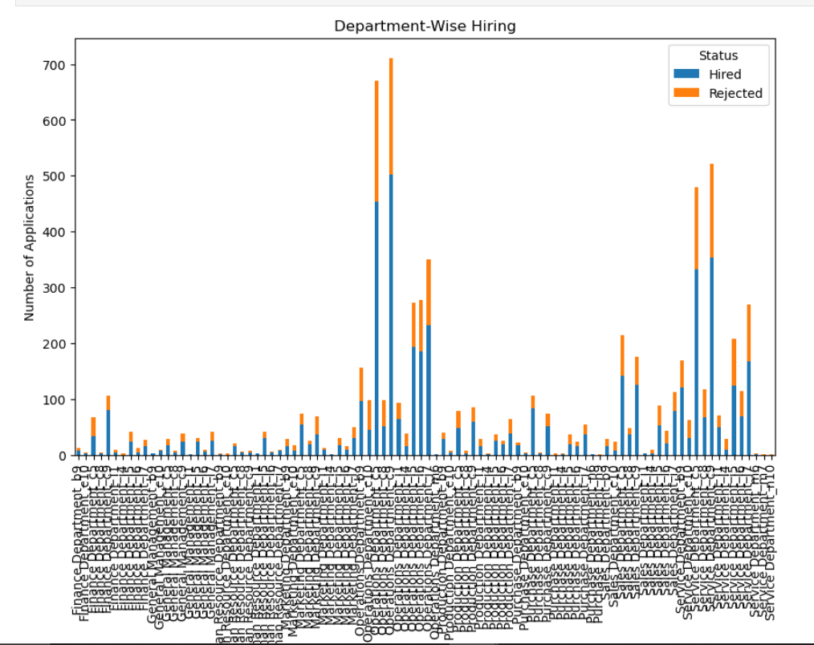
Creating visualizations to better understand the data.
Department wise hiring
In this plot we can see the distribution of Department_postName column that we created wrt the Status column that is number of applicants hired or rejected for a particular post in a particular department.

Slide 17
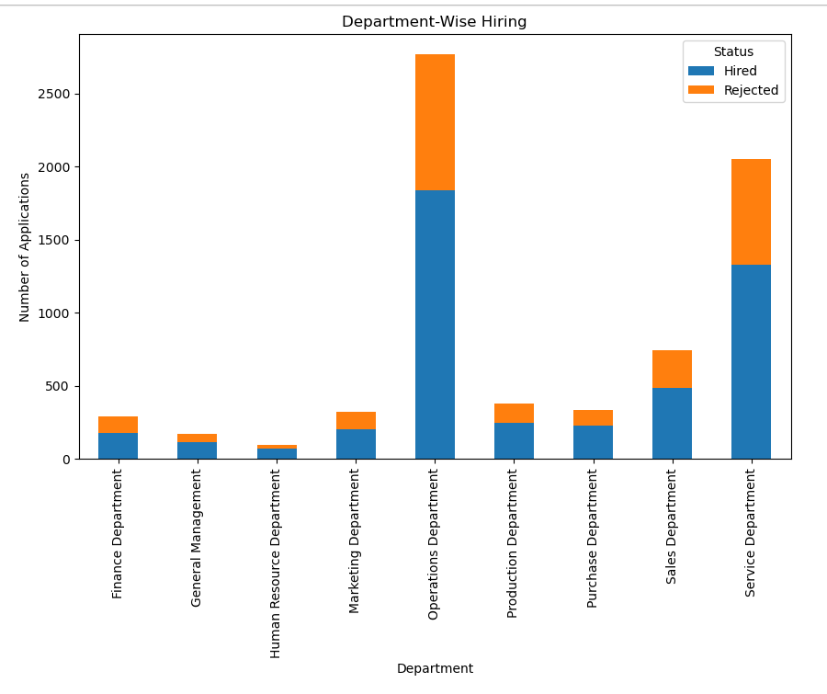
Creating visualizations to better understand the data.
We can look at Department wise Hiring:
Plot a column plot of people Hired and Rejected.
The Departments Operations and Service have recruited more people in this cycle. And HR dept has recruited the least number of people

Slide 18
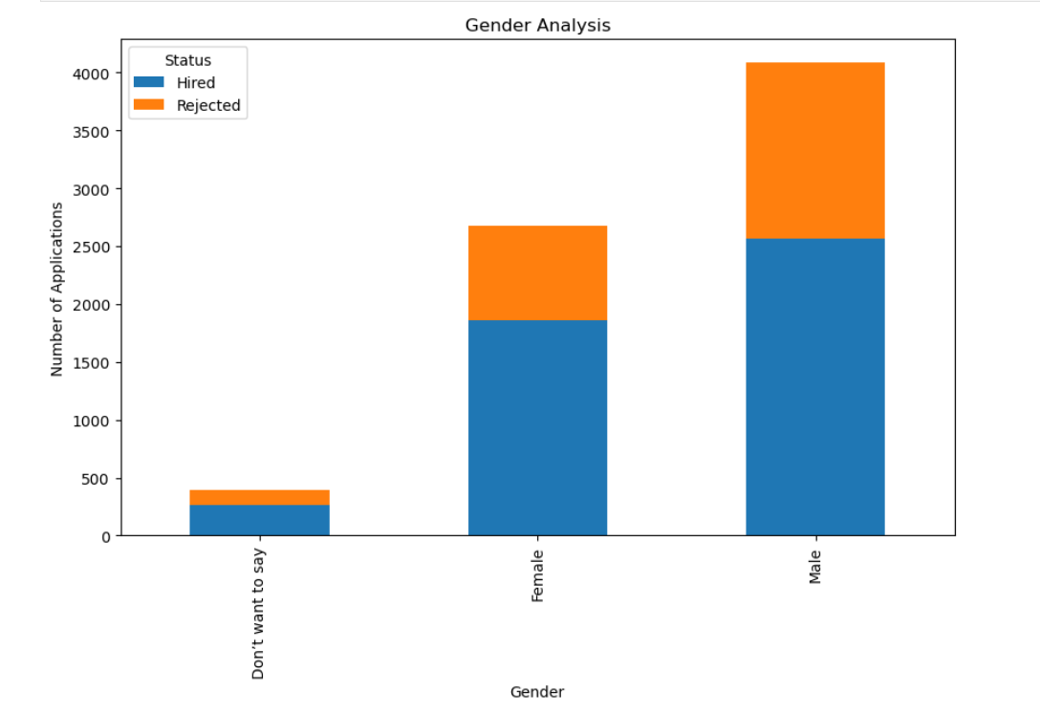
Creating visualizations to better understand the data.
Gender based Analysis
We can see that the organization has a relatively higher number of Male applicants than Female ones
But the organization hires a equal distribution of people across all genders. The organization does not discriminate between Male and Female employee hires

Slide 19
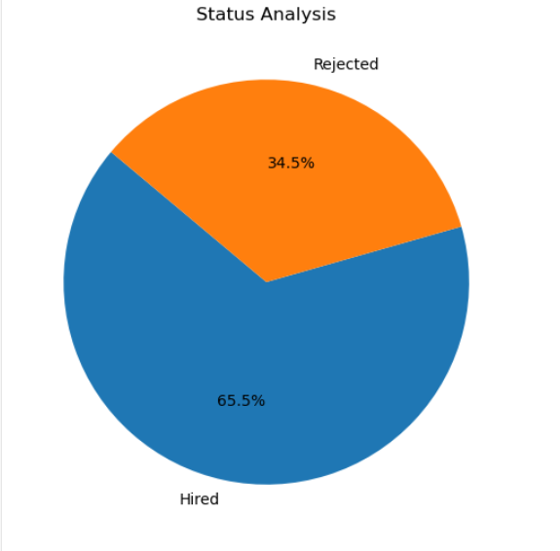
Creating visualizations to better understand the data.
Status Analysis
We can see that out of total applicants, almost 65.5% have the skills to get through all rounds and get hired.

Slide 20
Data Analytics Tasks

Slide 21
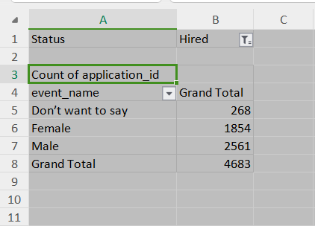
I. Hiring Analysis:
Your Task: Determine the gender distribution of hires. How many males and females have been hired by the company?
We can achieve this by using pivot tables to aggregate the data wrt Status and Event_name(Gender) columns
Steps:
Select pivot table on complete data
Take Status column as Filter column
Take Gender or event_name column as Rows column
Keep Count of Unique application id as the Values column
The PivotTable displays the count of male and female hires.

Slide 22
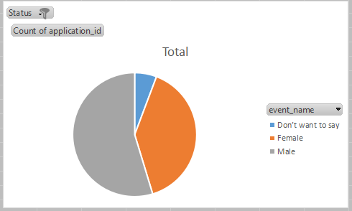
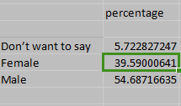
I. Hiring Analysis: continued
Insights:
The count of male is greater to that of female hires
Male hire percentage is 54.6% and female hire percentage is almost 40%
There are also few applicants about 6%, who do not want to disclose their gender

Slide 23

II. Salary Analysis:
Your Task: What is the average salary offered by this company? Use Excel functions to calculate this.
We can achieve this by using Average function in Excel on Offered Salary column
To avoid discrepancies in the result I have removed the outliers during preprocessing
Steps:
Select a blank cell in Excel
Use =AVERAGE(G2, G7149) function to calculate average of the Offered Salary column
Enter
Alternatively can also sum the offered salary column and then divide it by the count of records in that column
The cell will display the average salary offered by the company.

Slide 24
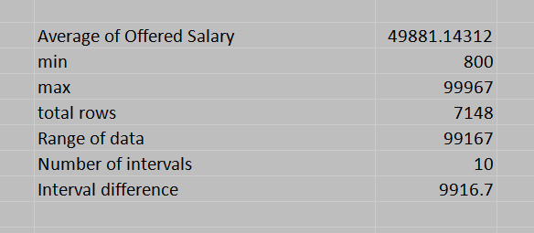
III. Salary Distribution:
Your Task: Create class intervals for the salaries in the company. This will help you understand the salary distribution.
We can achieve this by using Frequency function in Excel on Offered Salary column
Steps:
Decide on the intervals and create new column
Take min and max using MIN(), MAX() functions
Take difference of Min and Max values as range of the data
Take a number i.e. 10 for dividing the data into intervals.
Take range divided by no of intervals for Interval difference

Slide 25
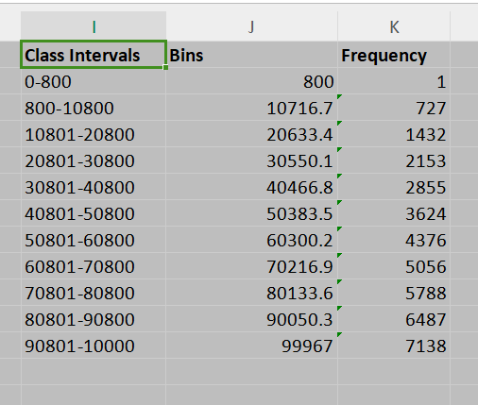
III. Salary Distribution: continued
Steps continued:
Then create a new column in data for making the intervals(bins) take formula =J2+$M$12 for calculating subsequent intervals
Use Frequency function to calculate frequencies
=FREQUENCY(G2:G7149,J2:J12)
This will give you the distribution of salaries across the intervals.

Slide 26
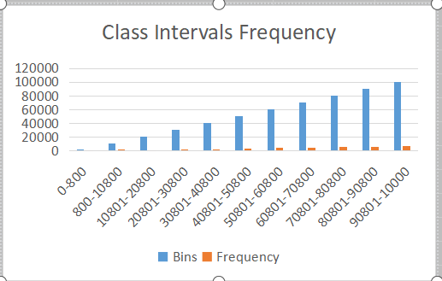
III. Salary Distribution: continued

Slide 27
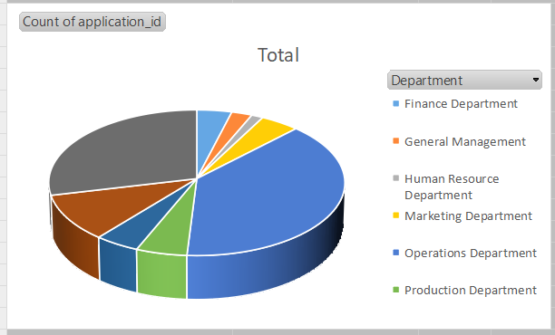
IV. Departmental Analysis:
Your Task: Use a pie chart, bar graph, or any other suitable visualization to show the proportion of people working in different departments.
We can achieve this by using pivot table to Aggregate data
Steps
Keep Department as Rows, and Count of Applicants in Values
Add pie chart for count of values
This will visualize the proportion of people working in different departments.

Slide 28
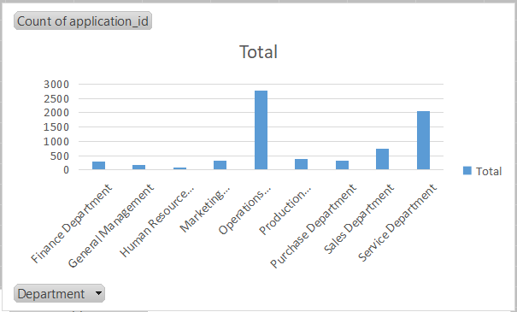
IV. Departmental Analysis: continued

Slide 29
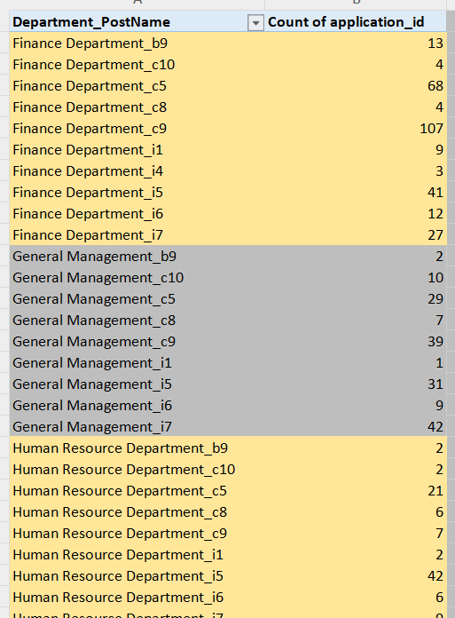
V. Position Tier Analysis:
Your Task: Use a chart or graph to represent the different position tiers within the company. This will help you understand the distribution of positions across different tiers.
We can achieve this by using pivot table to Aggregate data
Steps
Keep Department_PostName as Rows, and Count of Application ids in Values
Add column chart for count of values
This will represent the distribution of positions across different tiers.

Slide 30
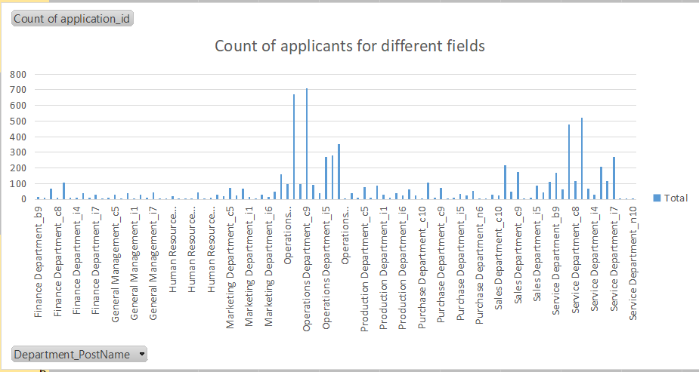
V. Position Tier Analysis: continued

Slide 31
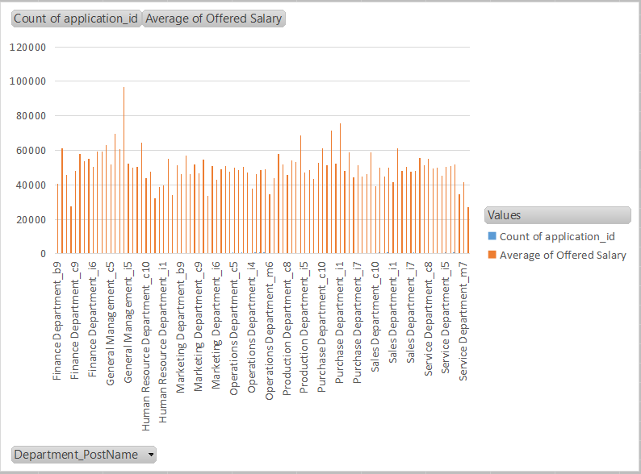
V. Position Tier Analysis: continued

Slide 32
Project Report

Slide 33
Project Report
Project Description
This project aims to analyze the hiring process data of a multinational company or organization
The objective is to draw meaningful insights from the data to help the hiring department improve its strategies and make better hiring decisions.
Key areas of focus include understanding gender distribution among hires, analyzing salary trends, examining departmental hiring patterns, and assessing the distribution of positions within the company.

Slide 34
Project Report
Approach
After downloading the dataset and loading it into Excel, I started with the following steps:
Went through the complete data and saw that few values were missing i.e. data values were either blank or hyphenated So i filtered for these values and removed them
Preprocessed the data like combining two column to make a new column, etc
Attempted few visualizations in Excel and EDA using python to get to know the data more
Performed Hiring and Salary Analysis as per task lists by solving each problem step by step, took help from Online Videos wherever required.

Slide 35
Project Report
Tech-Stack Used
WPS OFFICE version 12.2.0
Python ver 3.7.4 - ipynb files
Pandas, matplotlib libraries
VSCode ver 1.91.0
Jupyter-notebook link - https://drive.google.com/file/d/1njlgEJP0HH3VWUWPUv3Q_JSVMdULJ69t/view?usp=sharing

Slide 36
Project Report
Insights
The analysis revealed a balanced gender distribution among hires. There were no significant biases toward any gender, indicating that the company's hiring practices are equitable in terms of gender.
The average salary offered by the company was calculated, providing a benchmark for evaluating the company's compensation structure. This helps in understanding whether the company offers competitive salaries compared to industry standards.
The salary distribution analysis showed that most salaries fall within a specific range, with a few outliers at the higher end. This indicates that while the company generally offers competitive salaries, there are instances of significantly higher salaries, likely for senior or specialized roles.

Slide 37
Project Report
Insights continued
Outliers - The box plot identifies outliers in the salary data, which were mostly associated with high-salary positions. These outliers were expected and justified based on the roles and experience levels.
The departmental analysis highlighted which departments have higher hiring rates and which face more rejections. Departments like Operations and Service had the highest hiring rates, indicating robust growth or high turnover in these areas.
The position tier analysis revealed the distribution of hires across various levels, from entry-level to senior positions. This insight helps understand the company's hiring focus, whether it is more inclined towards bringing in fresh talent or hiring experienced professionals.

Slide 38
Project Report
Results
The gender analysis showed a balanced hiring practice, suggesting the company is committed to diversity and inclusion
The average salary analysis indicated that the company offers competitive compensation, which is crucial for attracting and retaining top talent
The high hiring rates in departments like Operations and Engineering suggest a strategic focus on these areas, possibly due to business expansion or high project demands
Understanding the distribution across different position tiers helps in workforce planning and career progression mapping for employees.
Identifying outliers helps in understanding salary anomalies and ensuring they are justified by the role's requirements and market standards.

Slide 39
Project Report
Conclusion:
The project provided valuable insights into the company's hiring process. Key findings highlighted a balanced gender distribution, competitive salaries, and a strategic focus on certain departments. The analysis also identified outliers in salary data, which are crucial for ensuring fair compensation practices. These insights can help the hiring department refine their strategies, improve hiring efficiency, and support the company's growth objectives.

Slide 40
Thank You
By Gayatri Palkar

